Slide 1
Analysis on Turnstile Data of NYC Subway
B. Vamsi Krishna – 17MIS7001
G. Sai Shashank – 17MIS7099

Slide 2


Abstract
The aim is to predict Entries_ hourly i.e. number of hourly entries at the New York city(NYC) subway based on other predictor variables.
Transport accessibility is an important characteristic of a particular building or territory, associated with the development of urban infrastructure and population density. In big cities, it is usually measured as the time required to get to the city center using public transport with a focus on the network of subway stations.
Analyse all the possible ways to travel in that subway.

Slide 3

Problem Definition
This analysis attempts to find a way to determine how long a passenger using a particular subway station is active elsewhere before returning to the subway station. If we can determine this, we can predict the lifestyles of users living or working in the area around a specific subway station

Slide 4
Literature Review
Deep study was done on The dataset.
Study of Stepwise Regression.
Coding for both Linear Regression and Stepwise Regression.

Slide 5
Algorithm (Model Deployed)
Linear Regression:
Stepwise Regression:
linear regression is a linear approach to modelling the relationship between a scalar response and one or more explanatory variables (also known as dependent and independent variables).
Stepwise linear regression is a method of regressing multiple variables while simultaneously removing those that aren't important. Stepwise regression essentially does multiple regression a number of times, each time removing the weakest correlated variable.

Slide 6
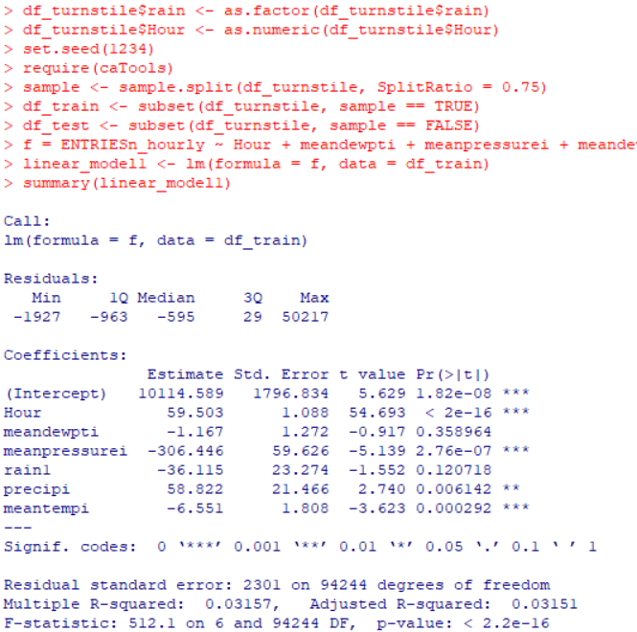

Test and train
With the split ratio of 75%

Slide 7
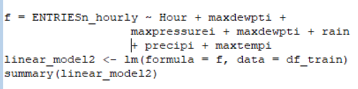
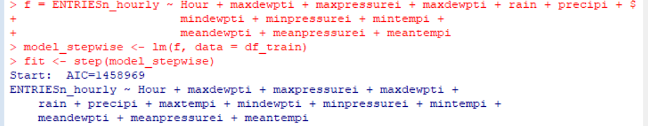
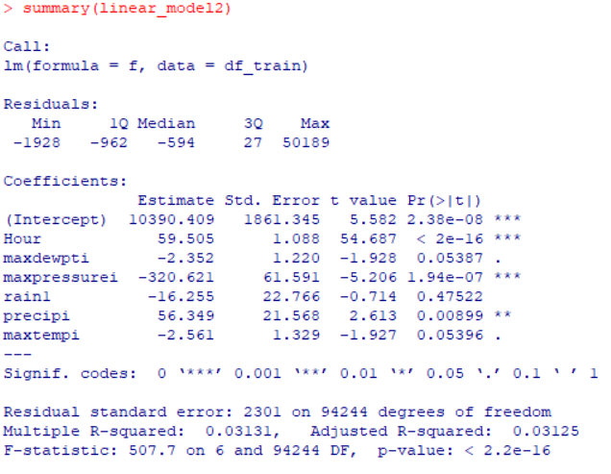
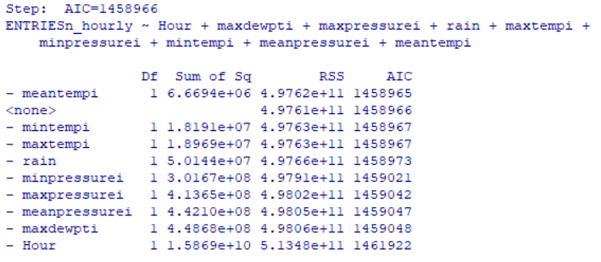
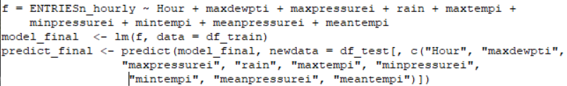
Lr and stepwise LR
LR
Stepwise LR

Slide 8
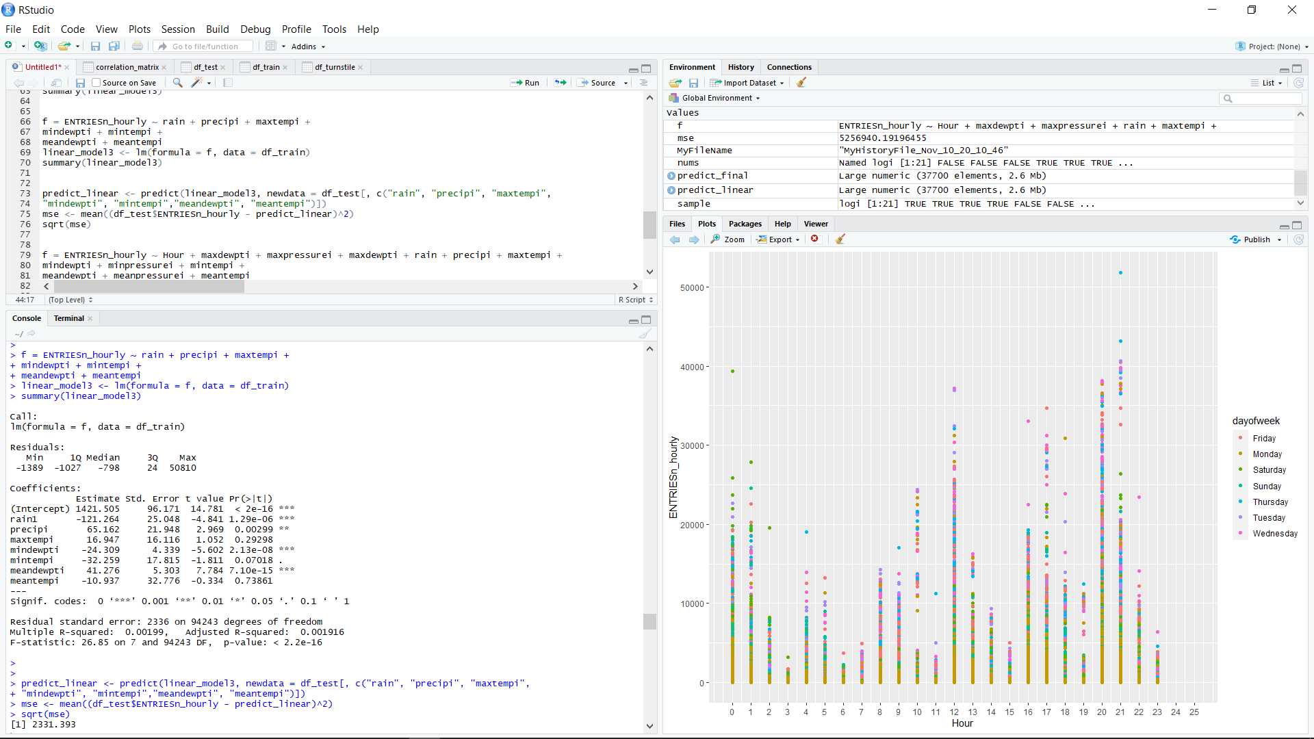
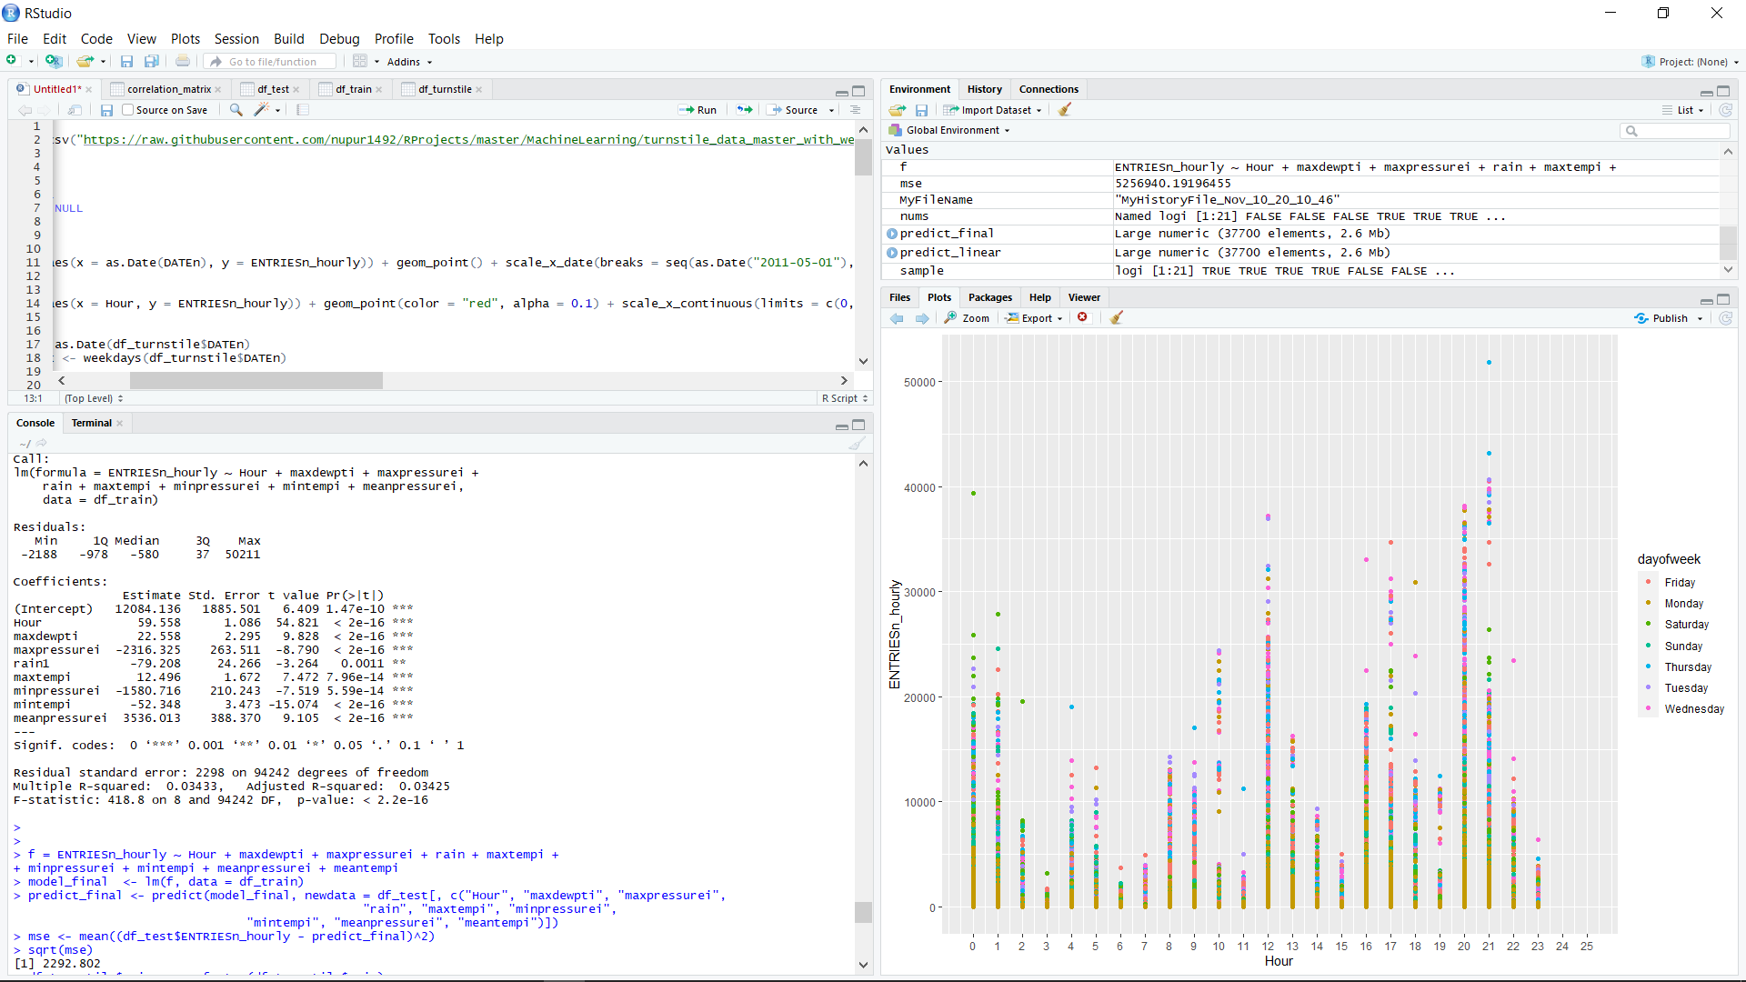
Error rate Analysis
Linear Regression
Step wise Regression

Slide 9
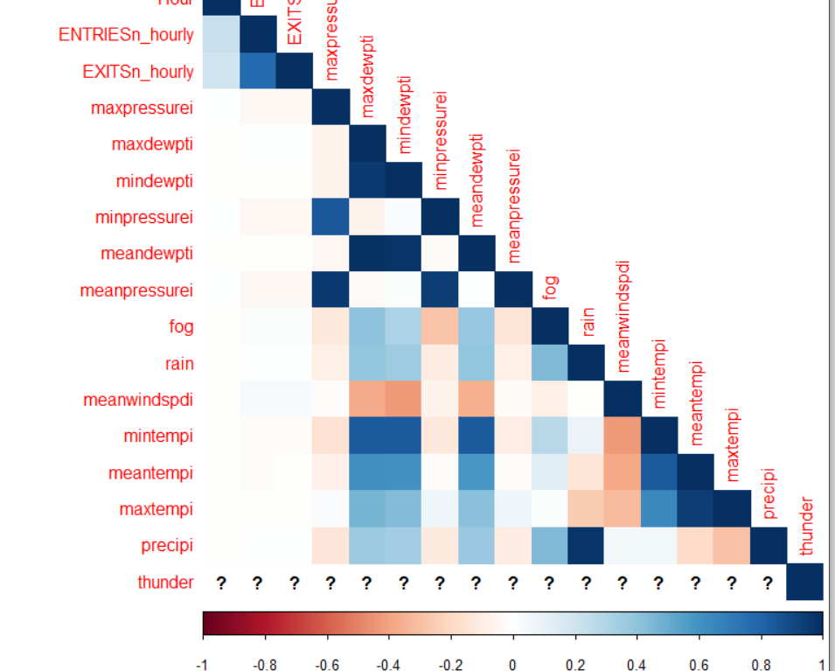
Correlation table

Slide 10
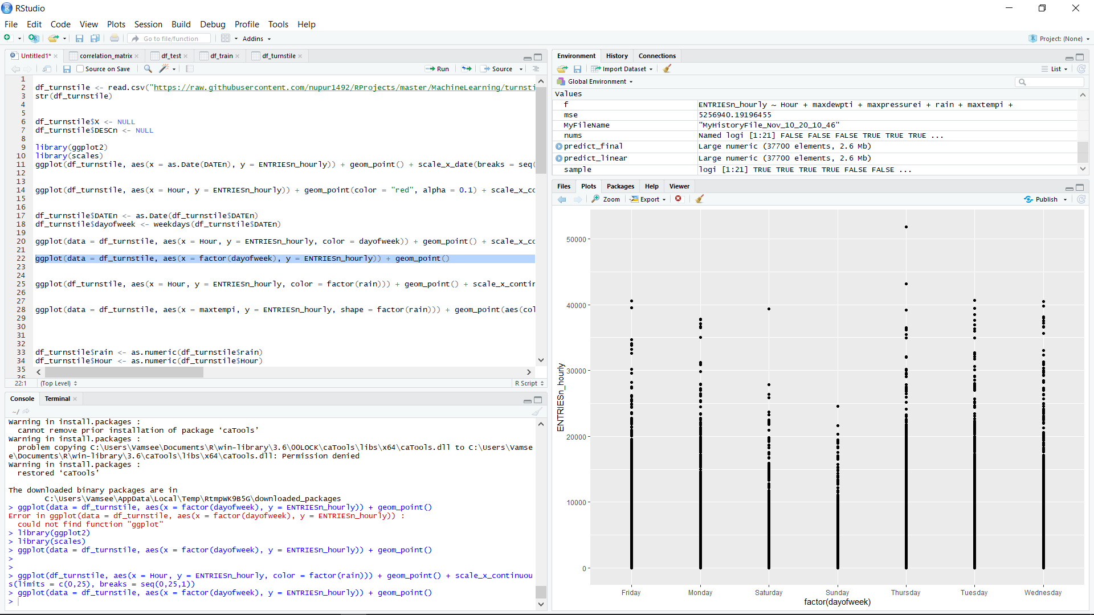
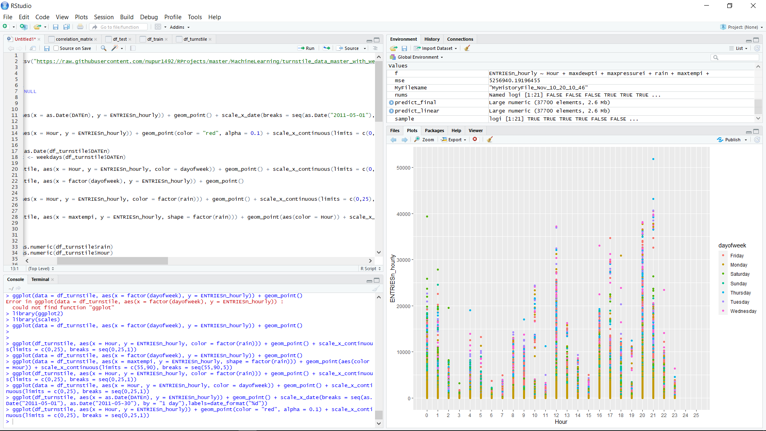
Results(1) based on exploratory analysis
These graphs shows the entries per hour every data of NYC subway

Slide 11
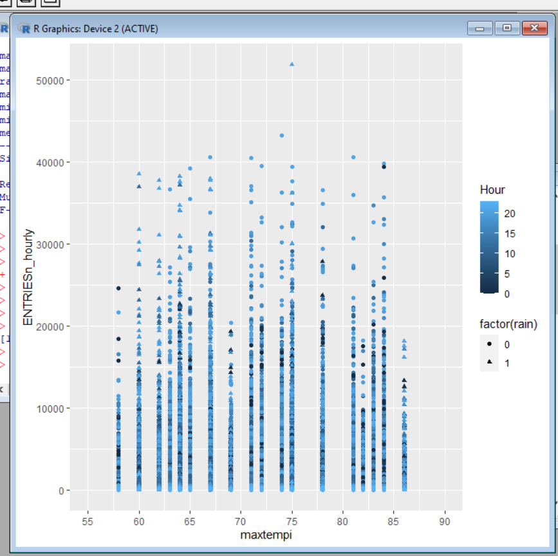
Results(2)

Slide 12
Discussion
As we see the there are millions of people every day in this subway stations.
By analysing this data set we can help all the people who goes to work and this also states that people often use public transport by considering other factors other than work like : Rain, spikes in temperature and etc,.
By gathering every bits and bytes of possibilities we can predict the safe hours with least errors as possible.
In this project we considered these things and used some techniques and compared both of them which gives the least amount of errors to facilitate the passengers a perfect time to travel.

Slide 13
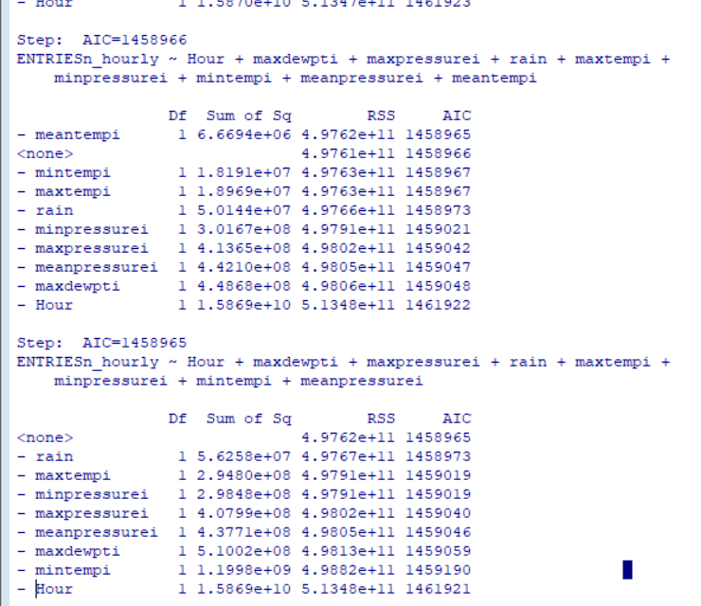
Results and discussion for Stepwise regression
It is the sum of the squared difference between the predicted and the actual values.
Lower the RSS, better the fit.
In general:
The step with less RSS sum of the columns gives the best output.

Slide 14

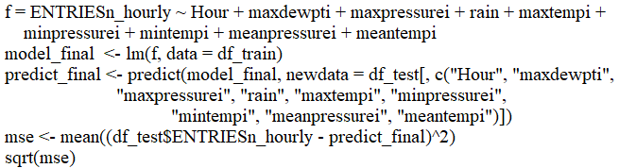

Comparison for lr and stepwise lr
LR
Stepwise LR
Observation was Mean square root error is less for Stepwise LR when compared to LR

Slide 15
Conclusion
Using this model, Metropolitan passengers would be able to predict the number of people expected at each subway stop, during different weather conditions, accounting for special events.
This would allow them to make preemptive arrangements to avoid any dangerous situations.
About the regressions.
When we compared to both Linear Regression and Stepwise regression, there’s a drop down of the error rate in Stepwise Regression.
So, We concluded that Stepwise regression is best model for this project.

Slide 16

References
https://nycdatascience.com/blog/student-works/mta-subway-data/
https://data.cityofnewyork.us/Transportation/Subway-Stations/arq3-7z49
https://www.kaggle.com/lenapiter/vienna-subway-network

Slide 17
Thank you ☺

